Slide 1


Web reminders
Web development
Notes:
© SUPINFO International University - http://www.supinfo.com
SUPINFO vous permet de partager ce document
Vous êtes libre de :
Partager — reproduire, distribuer et communiquer ce document Remixer — modifier ce document
A condition de respecter les règles suivantes :
Indication obligatoire de la paternité — Vous devez obligatoirement préciser l’origine « SUPINFO » du document au début de celui-ci de la même manière qu’indiqué par SUPINFO International University – Notamment en laissant obligatoirement la première et la dernière page du document, mais pas d'une manière qui suggérerait que SUPINFO International University vous soutiennent ou approuvent votre utilisation du document, surtout si vous le modifiez. Dans ce dernier cas, il vous faudra obligatoirement supprimer le texte « SUPINFO Official Document » en tête de page et préciser notamment la page indiquant votre identité et les modifications principales apportées.
En dehors de ces dispositions, aucune autre modification de la première et de la dernière page du document n’est autorisée.
NOTE IMPORTANTE : Ce document est mis à disposition selon le contrat CC-BY-NC-SA Creative Commons disponible en ligne http://creativecommons.org/licenses ou par courrier postal à Creative Commons, 171 Second Street, Suite 300, San Francisco, California 94105, USA modifié en ce sens que la première et la dernière page du document ne peuvent être supprimées en cas de reproduction, distribution, communication ou modification. Vous pouvez donc reproduire, remixer, arranger et adapter ce document à des fins non commerciales tant que vous respectez les règles de paternité et que les nouveaux documents sont protégés selon des termes identiques. Les autorisations au-delà du champ de cette licence peuvent être obtenues à support@supinfo.com.
© SUPINFO International University – EDUCINVEST - Rue Ducale, 29 - 1000 Brussels Belgium . www.supinfo.com

Slide 2

Course objectives
Web reminders
By following this course you will be able to:
Remember what is Internet and its evolutions.
Review the client / server model.
Review what is W3C
Review what is a REST architecture

Slide 3


Course plan
Web reminders
Internet presentation
Client/Server model
The W3C
REST Architecture

Slide 4

Internet Presentation
Web reminders

Slide 5


Internet
Internet presentation
Internet is a public worldwide computer network system
Use the standard Internet Protocol Suite (TCP/IP)
Network of networks
Public access to many resources and services

Slide 6

World Wide Web
Internet presentation
Abbreviated as WWW
Commonly known as the Web
Interlinked hypertext documents accessed via the Internet
May contain
Text
Images
Videos
Etc…

Slide 7
Uniform Resource Identifier
Internet presentation
URI : String of characters used to identify a resource on the Internet
Protocol used by server
Domain name
Name of the resource
Protocol
Site
File
http://www. webdev.com/Accueil/index.html
Host
Path
Path of access to a resource

Slide 8
Uniform Resource Identifier
Internet presentation
URI = URL + URN
Uniform Resource Identifier
URI
http://www.webdev.com/index.html
URL
URN
Uniform Resource Locator
Uniform Resource Name

Slide 9

HTML: The Web language
Internet presentation
HyperText Markup Language
Used to format a document
Descriptive language
Hypertext concept
Easy to use
Light Format
Current version : HTML5
Draft: HTML5.1

Slide 10

CSS: The Web Beauty
Internet presentation
Cascading Style Sheet
Used to add style to a document
Descriptive language
Clear and simple syntax
Current version : CSS3

Slide 11

JavaScript: The Web Logic
Internet presentation
Created by Brendan Eich
Used to add logic to a document
Interpreted language
Uses:
Weak-typing
Callbacks
Prototypes

Slide 12
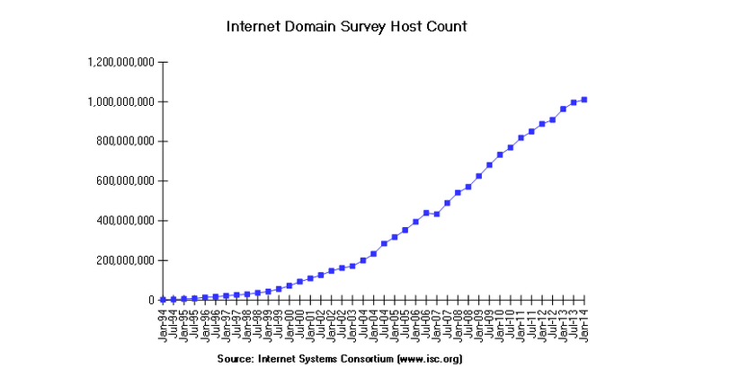
Internet Host Count
Internet presentation
Notes:
https://www.isc.org/services/survey/

Slide 13


Questions ?

Slide 14
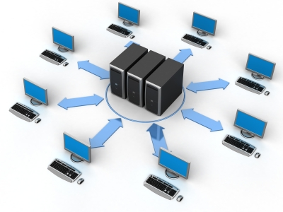
Client - Server
Web development

Slide 15
The HTTP protocol
Client - Server
HyperText Transfer Protocol
Communications protocol developed for the Web
Request/Response protocol
Client (browser)
Server (Web server)
Data transfer between a browser and a Web server
Stateless
Other protocols: FTP, POP, SMTP…

Slide 16
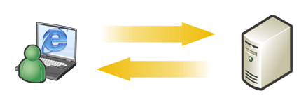
The HTTP protocol
Client - Server
The client transmits HTTP requests to the Web server to reach a resource.
1
The Web server answers at the request of each client by a HTML page or other resource.
2
1
2

Slide 17
HTTP request message
Client - Server
Composed of:
A request line composed of:
The request method used
The resource URI
The protocol and the version used
Several Headers
An empty line
An optional message body

Slide 18
HTTP request message
Client - Server
POST /en/html/index.html HTTP/1.1
Host: www.website.com
User-Agent: Mozilla/5.0 (Windows;en-GB; rv:1.8.0.11)
Accept: text/xml,text/html;q=0.9,text/plain;q=0.8,image/png,*/*;q=0.5
Accept-Language: en-gb,en;q=0.5
Accept-Encoding: gzip,deflate
Accept-Charset: ISO-8859-1,utf-8;q=0.7,*;q=0.7
Keep-Alive: 300
Connection: keep-alive
Content-Type: application/x-www-form-urlencoded
Content-Length: 39
name=MyName&male=yes

Slide 19
HTTP request methods
Client - Server
HTTP defines nine methods (or verbs):
GET: Request a representation of the resource
POST: Submit data to be processed to the identified resource
Data is included in the request body
HEAD: Like GET but return response headers only
PUT: Uploads a representation of the specified resource
DELETE: Deletes the specified resource
…

Slide 20
Response Status Codes
Client - Server
Status codes are divided into five classes :
1xx : Informational
Indicates a provisional response
2xx : Success
Indicates the request was received, understood, accepted and processed successfully
Examples :
200 OK
201 Created

Slide 21
Response Status Codes
Client - Server
Status codes are divided into five classes :
3xx : Redirection
Indicates that further action needs to be taken by the user agent in order to fulfill the request
Example :
301 Moved Permanently

Slide 22
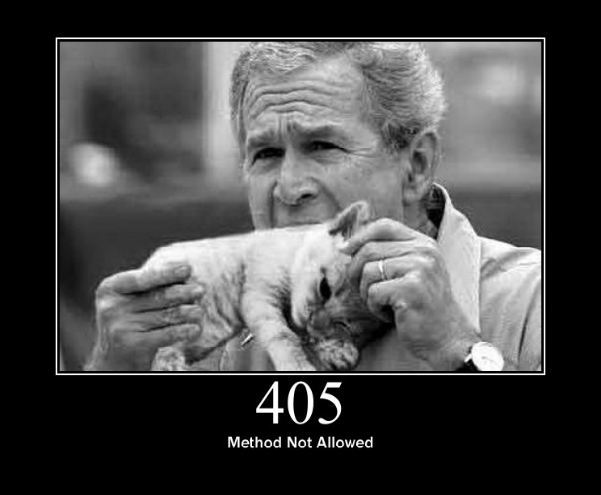
Response Status Codes
Client - Server
Status codes are divided into five classes :
4xx : Client Error
Intended for cases in which the client seems to have erred
Examples :
403 Forbidden
404 Not Found
405 Method Not Allowed

Slide 23
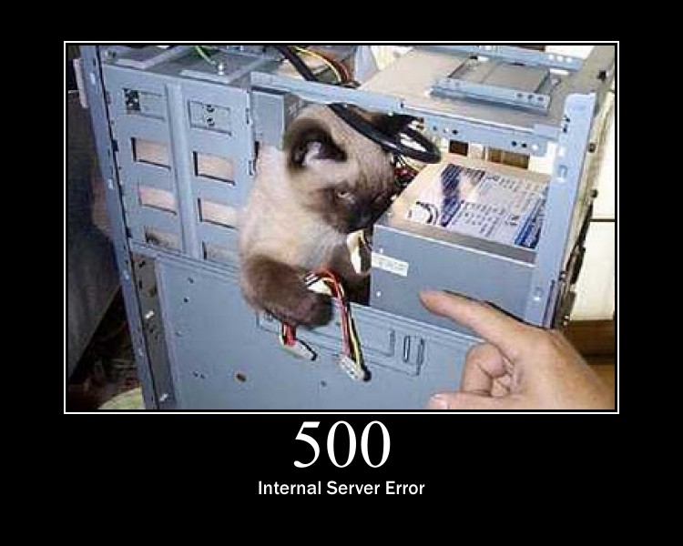
Response Status Codes
Client - Server
Status codes are divided into five classes :
5xx : Server Error
Indicate the server is aware that it has encountered an error or is otherwise incapable of performing the request
Examples :
500 Internal Server Error
501 Not Implemented

Slide 24
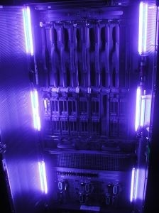
The Web Server
Client - Server
Receives HTTP requests and returns HTML pages or others (such as images, sounds, …)
Three servers dominate the market :
Apache HTTP Server (52.3%)
NginX (14.4%)
Microsoft IIS (11.3%)

Slide 25




Browsers
Client - Server
Three main browsers:
Internet Explorer
Mozilla Firefox
Google Chrome

Slide 26




Browsers
Client - Server
Other browsers…
Epiphany
Safari
Opera
. . .
Konqueror

Slide 27

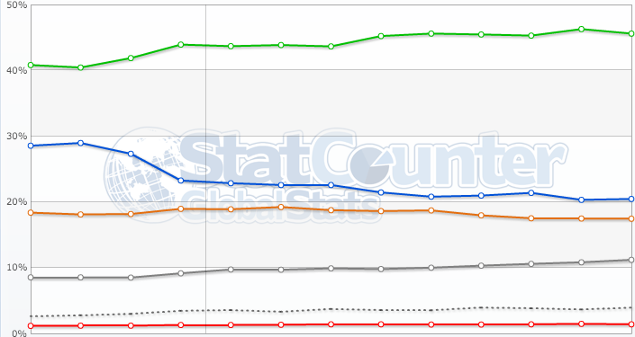
Browser use chart
Client - Server
IE
Chrome
Firefox
Safari
Opera
Others (dot)
From september 2013 to september 2014
Notes:
Source: http://gs.statcounter.com/

Slide 28
Questions ?

Slide 29

The W3C
Web development
Discovering internet normalizations

Slide 30
What is the W3C?
The W3C
Stands for World Wide Web Consortium
Normalization organism
Created in 1994
Managed by MIT, ERCIM and Keio university

Slide 31

Purpose of the W3C
The W3C
He promotes:
Web technologies compatibility (recommendations)
More information : http://www.w3.org/
He creates standards

Slide 32
RESTful Architecture
Representational State Transfer

Slide 33
What is REST ?
RESTful Architecture
The term comes from Roy Fielding’s doctoral dissertation
REpresentational State Transfer
REST was initially described in the context of HTTP, but it is not limited to that protocol
Notes:
Roy Thomas Fielding is a co-creator of HTTP 1.0, HTTP 1.1, and URI RFCs

Slide 34
What is REST ?
RESTful Architecture
Roy defines a RESTful system with the following constraints :
It must be a client-server system
It has to be stateless
It has to support a caching system
It has to be uniformly accessible
It has to be layered (support scalability)
It may be able to transfer executable code

Slide 35
Client-Server system
RESTful Architecture
Separation of concerns
Separation between the clients & data storage
Simple server components
Portability improvement
Scalability improvement

Slide 36
Stateless
RESTful Architecture
Each request must contain all of the information necessary to understand it
No stored context on the server
Session state is on the client

Slide 37
Cache
RESTful Architecture
Responses must be implicitly or explicitly labeled as cacheable or non-cacheable
Potential intermediary components:
Proxies, Shared caches
Always think about the durability

Slide 38
Resource
RESTful Architecture
A RESTful resource is anything that is addressable over the Web
Resource examples are :
The temperature in Paris at 8:00 PM
A blog post
A list of Bug Reports inside a BTS
A search result in Google

Slide 39
Representation
RESTful Architecture
A Representation is typically a document that captures the current or intended state of a resource
It’s what is sent back and forth between clients and servers

Slide 40
Representation
RESTful Architecture
Can take various form such as :
One resource can have more than one representation
But with the same URI
HTML Document
Plain Text
XML Stream
JSON Stream
…

Slide 41
RESTful Web Services
RESTful Architecture
Also called RESTful web API, it’s a simple web service implemented using HTTP and the principles of REST
The URI of a resource is available as an hyperlink in the representations

Slide 42
RESTful Web Services
RESTful Architecture
The HTTP protocol provides methods on which we can map CRUD operations
And so apply different actions with the same URI !
Data Action | HTTP protocol equivalent
CREATE | POST
RETRIEVE | GET
UPDATE | PUT
DELETE | DELETE

Slide 43
A Web API Example
RESTful Architecture
An example of a Web API is available at the following URL :
http://restful-example.appspot.com/
It provides CRUD operations on a student list
We’ll use them as example in the course

Slide 44
GET / Retrieve
RESTful Architecture
A GET request to the URI /students return all the students :
<students>
<count>2</count>
<student>
<birthDate>5287-09-15T22:00:13.524Z</birthDate>
<firstName>Jack</firstName>
<idBooster>59253</idBooster>
<lastName>Harkness</lastName>
</student>
...
</students>

Slide 45
GET / Retrieve
RESTful Architecture
And a GET request to the URI /students/59253 returns Jack:
<student>
<birthDate>5287-09-15T22:00:13.524Z</birthDate>
<firstName>Jack</firstName>
<idBooster>59253</idBooster>
<lastName>Harkness</lastName>
</student>

Slide 46
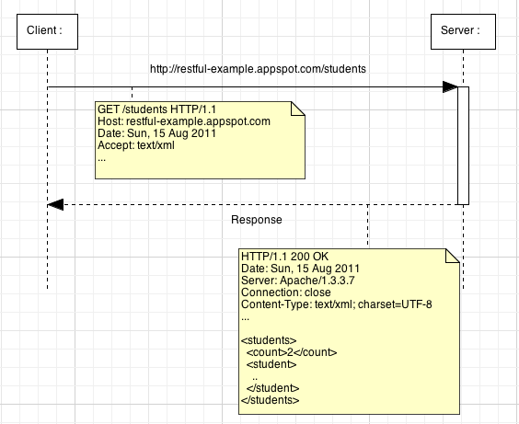

Slide 47
POST / Create
RESTful Architecture
We want to add Joe
A Joe XML representation looks like this :
<student>
<birthDate>1946-06-28T22:00:13.524Z</birthDate>
<firstName>Joe</firstName>
<idBooster>65442</idBooster>
<lastName>Dalton</lastName>
</student>

Slide 48
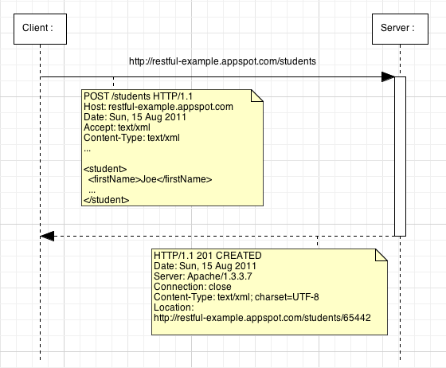
Notes:
The response of a POST request can contain a body but in that example we prefer use the 201 status code with a Location header with the new resource URI.

Slide 49
PUT / Update
RESTful Architecture
We want to update Joe
Updated Joe representation looks like this :
<student>
<birthDate>1946-06-28T22:00:13.524Z</birthDate>
<firstName>Joeffrey</firstName>
<idBooster>65442</idBooster>
<lastName>Dalton</lastName>
</student>

Slide 50
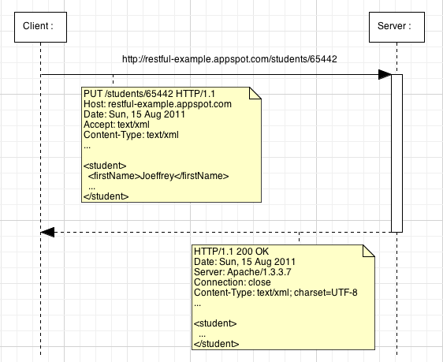

Slide 51
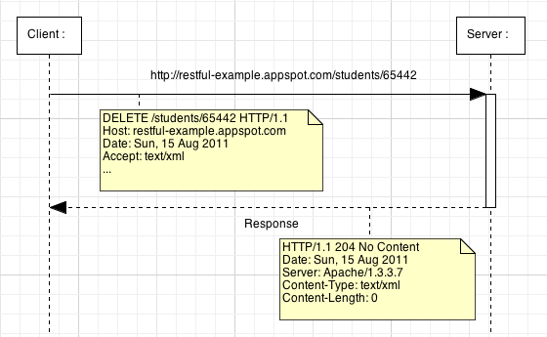
DELETE / Delete
RESTful Architecture

Slide 52
RESTful Web Services
RESTful Architecture
Web API are not always simple CRUD
Choose the verb that best matches to the behavior of your service !

Slide 53
Questions ?

Slide 54

The end
Web reminders
Thanks for your attention

